Slide 1


MUSIC Algorithm for DOA Estimation of Multiple Sources
Sdet project presentation
Sasanka grs - 2019112017

Slide 2

Introduction
Processing the signals received on an array of sensors for the location of the source is of great interest considering the general physical signal phenomena.
The general problem considers sensors with arbitrary locations and arbitrary directional characteristics (gain/phase/polarization) in a noise environment of arbitrary covariance matrix.
The term Multiple signal classification (MUSIC) is used to describe experimental and theoretical techniques involved in determining the parameters of multiple wavefronts arriving at sensor array from measurements made on the signals received at the array elements.

Slide 3
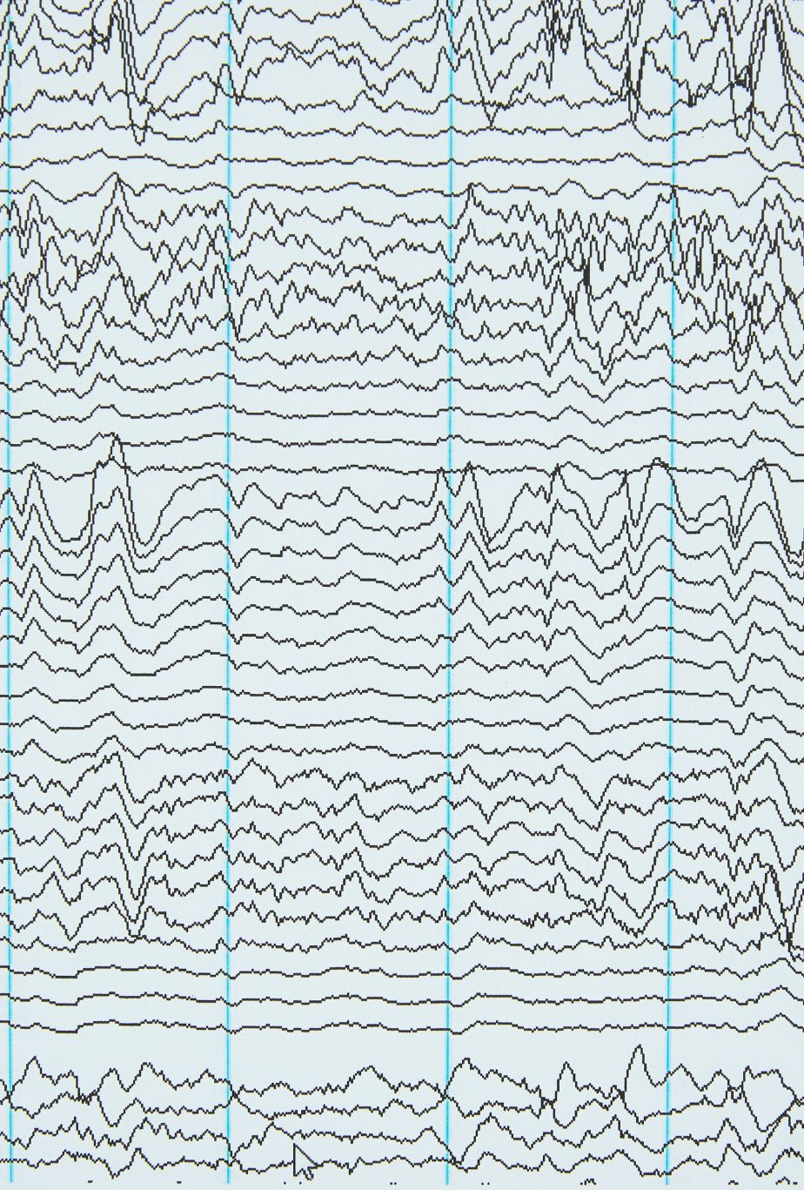
deliverables using music
A description is given of the multiple signal classification (MUSIC) algorithm, which can be used to provide asymptotically unbiased estimates of
Number of incident wavefronts present
Directions of arrival (DOA) (or emitter locations)
Strengths and cross correlations among the incident waveforms
Noise strength.
Examples and comparisons with methods based on maximum likelihood (ML) and maximum entropy (ME), as well as conventional beamforming are included. A simulation for directions of arrival (DOA) Estimation is performed to show the efficiency and parameter performance analysis of the proposed algorithm.

Slide 4
Array model
We consider an array of M elements, receiving D wavefronts corresponding to the D signal sources, and additive noise. Thus, the multiple signal classification approach begins with the following model for characterizing the received M vector X as:
X = AF + W
Here, X is the observed vector at the M array elements. Columns of A represent the ”steering vectors” or ”mode vectors” which are based on signal arrival angles and array element locations. The element A_{ij} represents the signal due to j^{th} source on i^{th} array element.
The complex quantities F₁, F₂, ..., F_{D} which are the elements of F matrix represent the incident signals, namely amplitude and phase representations of obtained wavefronts. The W vector represents noise.

Slide 5

Music algorithm
The algorithm can be briefly divided into
Finding the Covariance matrix S of X
Eigen decomposition of S
Estimating number of signals/sources (Dˆ)
Separating Signal and Noise Subspaces
Obtaining the P_{MU} (θ) matrix and evaluating its value vs θ
Picking D peaks of P_{MU} (θ)
Calculate other parameters

Slide 6
S matrix
S matrix is defined as the Covariance matrix of the observed vector X. It is mathematically denoted by
S = APA∗ + λS₀
S₀ is the scaled version of Noise Covariance matrix.
Here, we assume that P = FF∗. It is also assumed above that the signal and noise are uncorrelated.

Slide 7

Solution with eigen decomposition
If number of array elements are less than the number of incident signals (equivalent to number of sources) (D < M), the matrix APA∗ will be singular with rank < M. Therefore
|APA∗| = |S − λS₀| = 0
This equation resembles the eigen decomposition of matrix S in the metric of S₀. But, as A is full rank and P is positive definite, APA∗ must be non-negative definite. This constraints the λ to be the minimum eigen value λ_{min}. Using this information, we can rewrite S as
S = APA∗ + λ_{min}S₀

Slide 8
Estimating number of sources/signals
From previous analysis, we obtain the rank of APA∗ = D. Thus, we can conclude that λ_{min} occurs N = M − D times in the eigen values. This is true because the eigen values of S and S − λ_{min}S₀ = APA∗ differ by λ_{min} always.
Since the minimum eigen value of APA∗ is 0, λ_{min} must repeat N times, which corresponds to the noise subspace. Therefore, the number of incident signals can be estimated as
Dˆ = M − Nˆ
Here, Nˆ is the multiplicity of λ_{min}(S, S₀).

Slide 9
Signal and noise subspaces
Since S = APA∗ + λ_{min}S₀, we can rewrite the previous equation as
APA∗ e_{i} = (λ_{i} − λ_{min})S₀e_{i}
From the above equation, we can observe that each time λ_{i} = λ_{min}, we must have A∗ e_{i} = 0. This clearly implies that the eigen vectors associated with λ_{min}(S, S₀) are orthogonal to the space spanned by the columns of A, the incident mode vectors.
Thus, we can separate the N −dim subspace spanned by N noise vectors and the D − dim subspace spanned by D incident signal mode vectors.

Slide 10
Obtaining P_{MU}(θ) vs θ
Assuming E_{N} denotes the N noise eigen vectors, we can obtain the normal Euclidean distance of the vector a(θ) from EN to be d² = a∗(θ)E_{N}E_{N}∗a(θ).
We use the inverse of this to obtain
P_{MU} (θ) = 1/a∗(θ)E_{N} E_{N}∗a(θ)
We can see that this is an asymptotically unbiased estimator, even for multiple incident wavefronts.

Slide 11
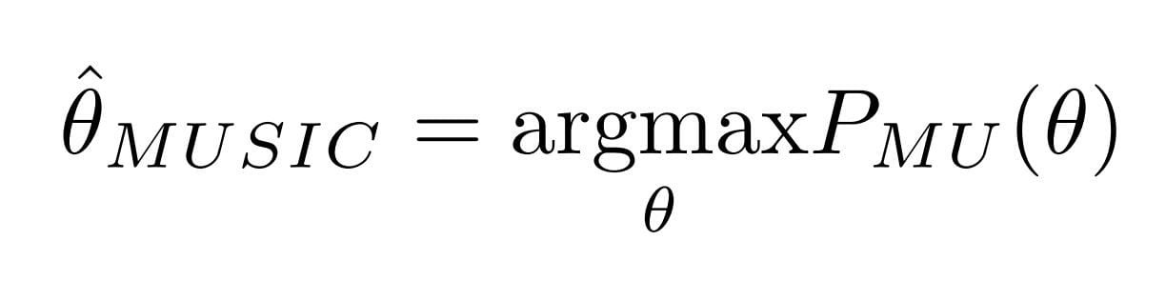
Peak picking and doa estimation
The final step involves the estimation of the direction of arrival (DOA) using the P_{MU} (θ) matrix. The estimate is the choice of θ for which the P_{MU} (θ) function is maximized. It can be mathematically represented as

Slide 12

Intuition behind peak picking
By intuition, we can see that the denominator in the function P_{MU} (θ) is the Euclidean Distance between a(θ) and E_{N} . By convention, we obtain this to be minimum when the angle θ is the actual direction of arrival.
Thus, we pick the first D peaks of the function P_{MU} (θ), to obtain an estimate to the actual direction of arrival.

Slide 13
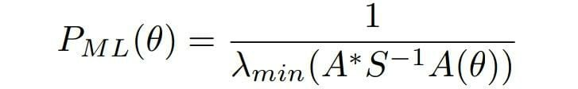
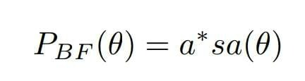
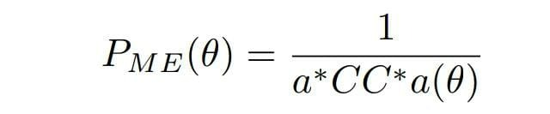
Comparison with other estimators
Some of the other estimators compared with are ordinary beamforming (P_{BF} (.)), ML(maximum likelihood) P_{ML}(.) and ME (maximum entropy) (P_{ME}(.)). They are given by

Slide 14
simulations
Considering (for simplicity) a ULA (Uniform Linear Array), the model can be described as described in Section-II, with some extra parameters like snapshots (number of time instants of data), Spacing between the array elements (this quantity will be a single number as the array is uniform and linear) and frequency of incident signals.
The simulation of Direction of Arrival Estimation for a D = 2, M = 10, snapshots=20, wavelength(λ)=150, spacing(d) = λ/2 , incident signals are sinusoidal with amplitude 2 and frequencies π 4 and π 3 at angles of −30º and 70º , and SNR=20

Slide 15
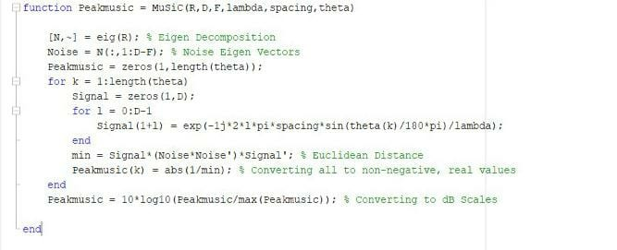
Code snippets – Music algorithm

Slide 16
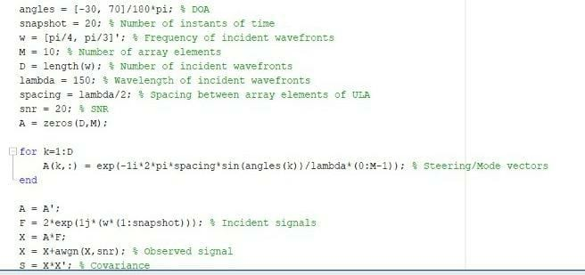
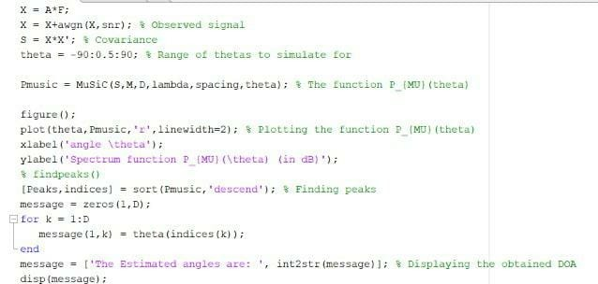
Code snippets – Music Simulation pre-req

Slide 17


Live simulation

Slide 18
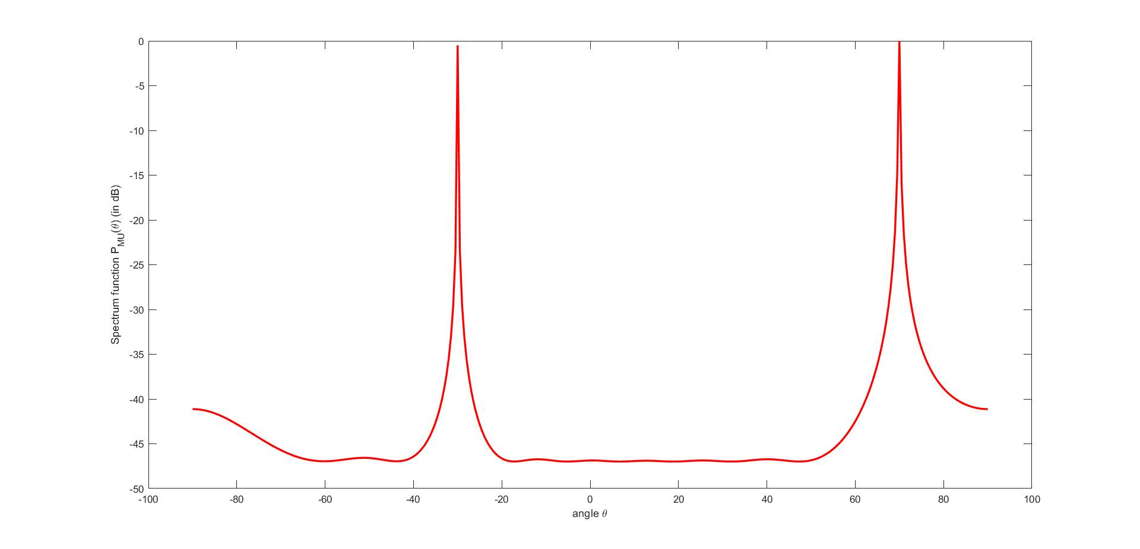
Simulation result

Slide 19

Experiments and observations
Considering the same model as in the previous simulation, parameter-based experiments of the working of the MUSIC algorithm for Direction of Arrival (DOA) Estimation can be conducted, some of which include
The Spacing between Array Elements
Increasing Number of Antenna Array Elements
Increasing the Number of Snapshots
Increasing the Signal Incidence Angle Difference

Slide 20
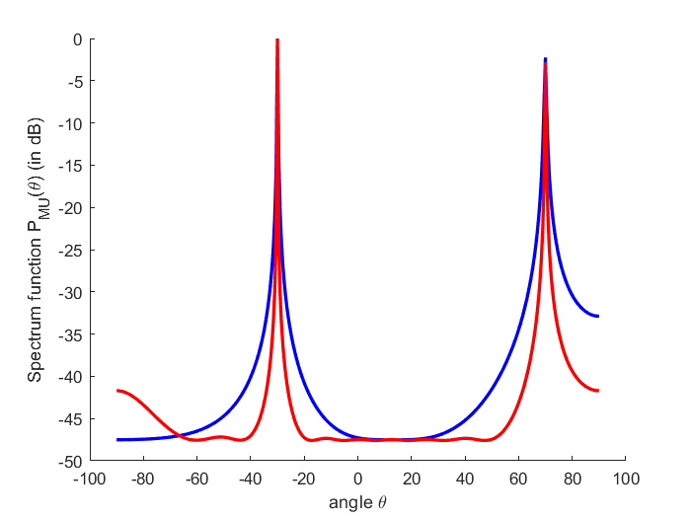
Spacing between array elements
d = λ/6 (blue) and d = λ/6 (red)

Slide 21
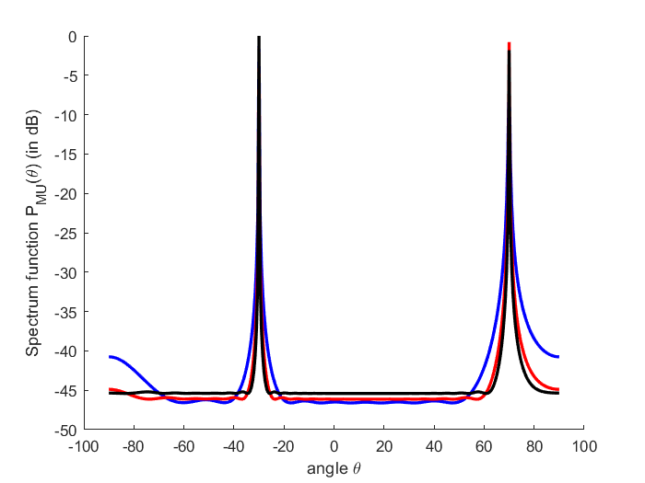
Number of array elements
M = 10 (blue), M = 20 (red), M = 30 (black)

Slide 22
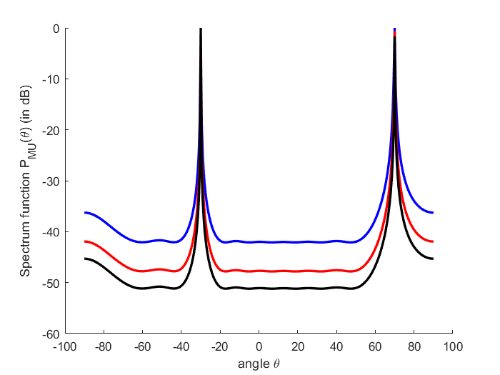
Number of snapshots
snapshots = 10 (blue), snapshots = 20 (red) and snapshots = 30 (black)

Slide 23
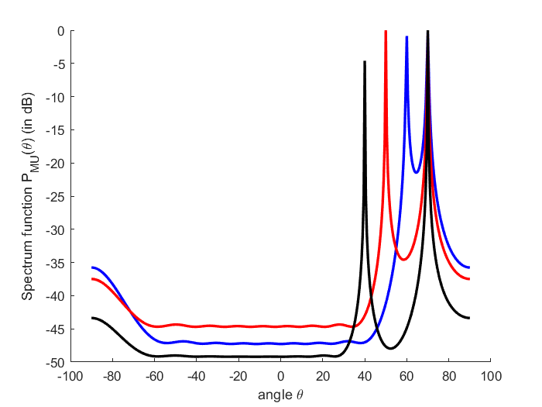
Signal incidence angle difference
difference in angles 10⁰ (blue), 15⁰ (red) and 20⁰ (black)

Slide 24
conclusion
The approach presented here for multiple signal classification is very general and of wide application. MUSIC provides asymptotically unbiased estimates of a general set of signal parameters approaching the Cramer-Rao accuracy bound.
MUSIC models the data as the sum of point source emissions and noise rather than the convolution of an all-pole transfer function driven by a white noise (i.e., autoregressive modeling, maximum entropy) or maximizing a probability under the assumption that the X vector is zero mean, Gaussian (maximum likelihood for Gaussian data).
As there are no constraints placed on array geometry, this algorithm can be scaled to a variety of array-structure independent problems. Also, with no constraints placed on the statistical model of noise, it can be generalized to various problems with non-AWGN noise processes also.

Slide 25
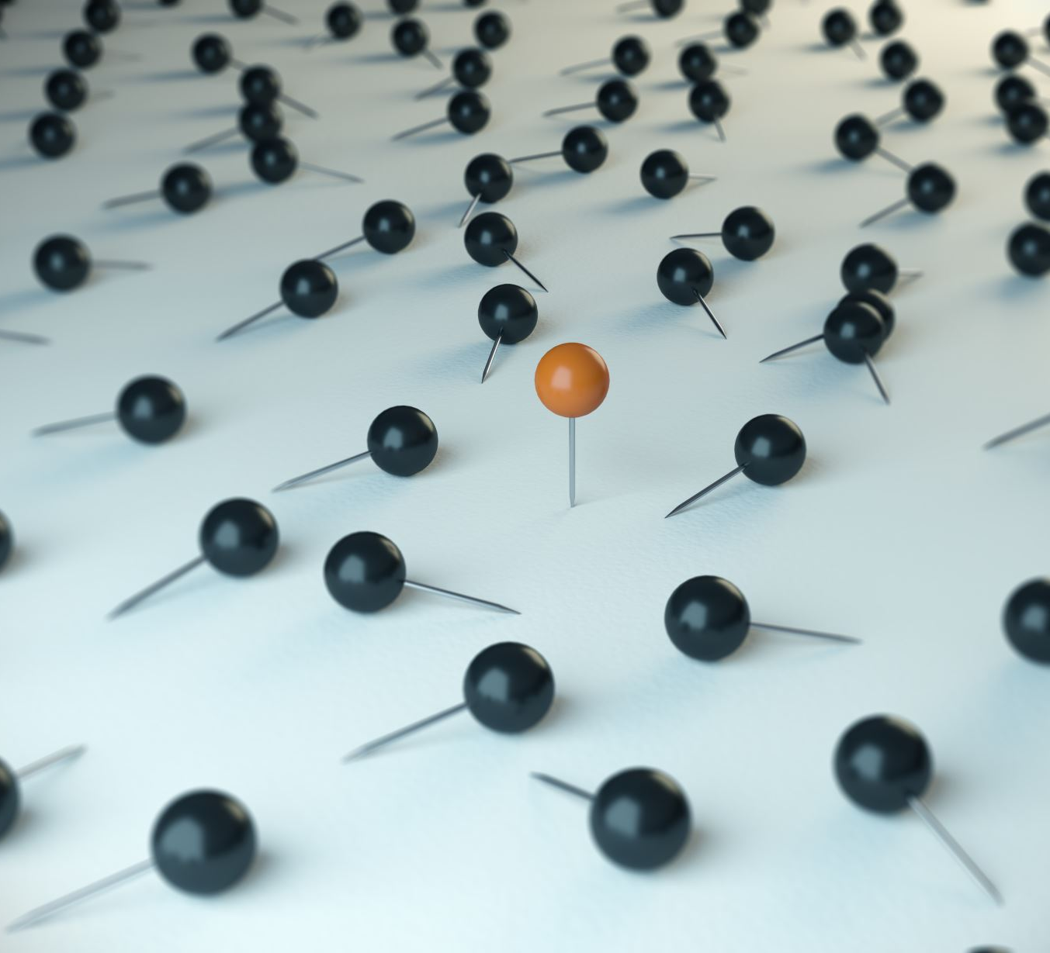
references
[1] R. Schmidt, ”Multiple emitter location and signal parameter estimation,” in IEEE Transactions on Antennas and Propagation, vol. 34, no. 3, pp. 276-280, March 1986
[2] Ward, Darren B., Zhi Ding, and Rodney A. Kennedy. ”Broadband DOA estimation using frequency invariant beamforming.” IEEE Transactions on Signal Processing 46.5 (1998): 1463-1469.
[3] Stoica, Petre, and Alex B. Gershman. ”Maximum-likelihood DOA estimation by data-supported grid search.” IEEE Signal Processing Letters 6.10 (1999): 273-275.
[4] Abramovich, Yuri I., et al. ”Positive-definite Toeplitz completion in DOA estimation for nonuniform linear antenna arrays. I. Fully augmentable arrays.” IEEE Transactions on Signal Processing 46.9 (1998): 2458- 2471.
[5] https://github.com/Sasanka-GRS/SDET-Project , Codes and Plots are available here.
[6] Gupta, Pooja, and S. P. Kar. ”MUSIC and improved MUSIC algorithm to estimate direction of arrival.” 2015 International Conference on Communications and Signal Processing (ICCSP). IEEE, 2015.

Slide 26

THANK YOU

